Slide 1

Template Method Design Pattern
Aashit Shah
Chandni Vora
Rohil Singh

Slide 2

Agenda
The Template Method Pattern
Participants
Implementation Issues
Class Diagram
Template Method Content
Abstract Class
Concrete Class
Test Client
Implementation

Slide 3
The Template Method Pattern
Intent
  It is a behavioral design pattern. Define the skeleton of an algorithm in an operation, deferring some steps to subclasses. Template Method lets subclasses redefine certain steps of an algorithm without changing the algorithm's structure.
Motivation
  Sometimes you want to specify the order of operations that a method uses, but allow subclasses to provide their own implementations of some of these operations

Slide 4
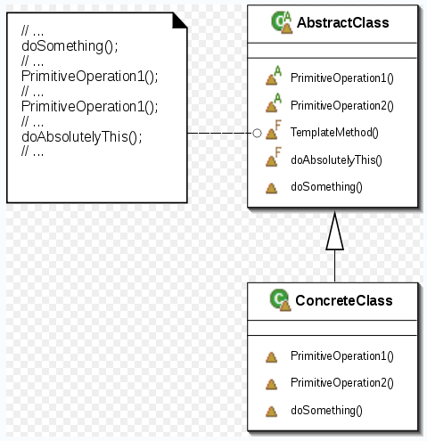

Participants
Collaborations
ConcreteClass relies on AbstractClass to
implement the invariant steps of the algorithm.

Slide 5
Participants
Abstract class
  Defines abstract primitive operations that concrete subclasses define to implement steps of an algorithm.
  Implements a template method defining the skeleton of an algorithm. The template method calls primitive operations as well as operations defined in AbstractClass or those of other objects.
Concrete class
  implements the primitive operations to carry out subclass-specific steps of the algorithm.

Slide 6
Implementation Issues
Operations which must be overridden by a subclass should be made abstract
If the template method itself should not be overridden by a subclass, it should be made final
In a template method, the parent class calls the operations of a subclass and not the other way around. This is an inverted control structure that’s sometimes referred to as "the Hollywood principle," as in, "Don't call us, we'll call you".

Slide 7
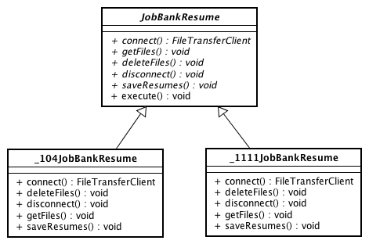





Class Diagram
Abstract primitive
operations
Template method
implement primitive operations
implement primitive operations

Slide 8
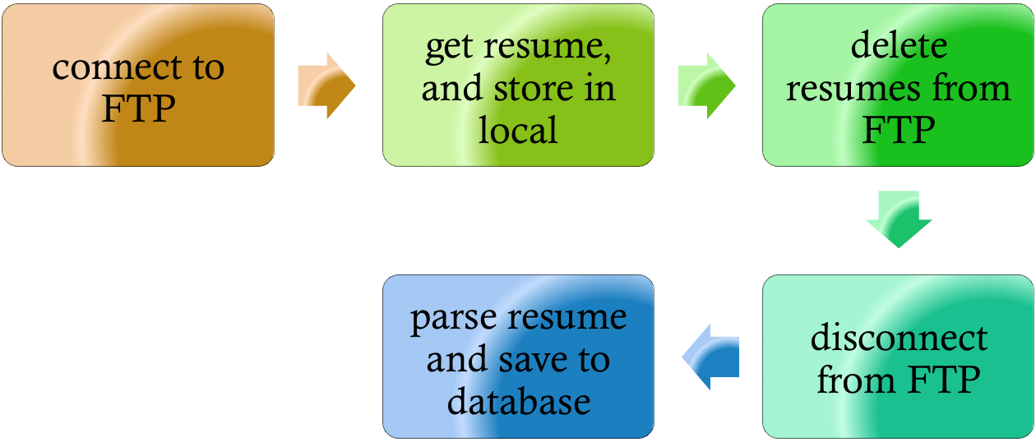
Template Method Content

Slide 9
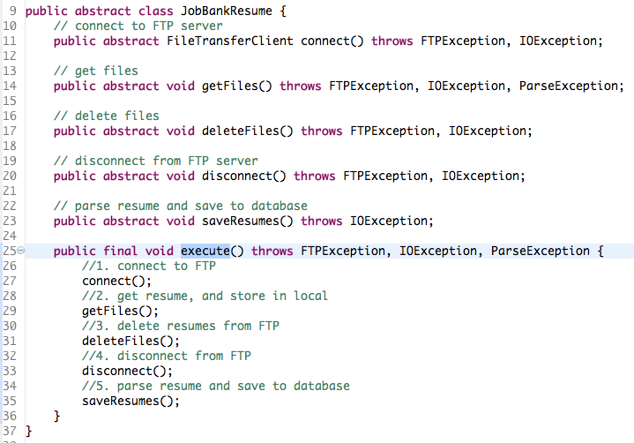




Abstract Class
Abstract primitive operations
Template method

Slide 10

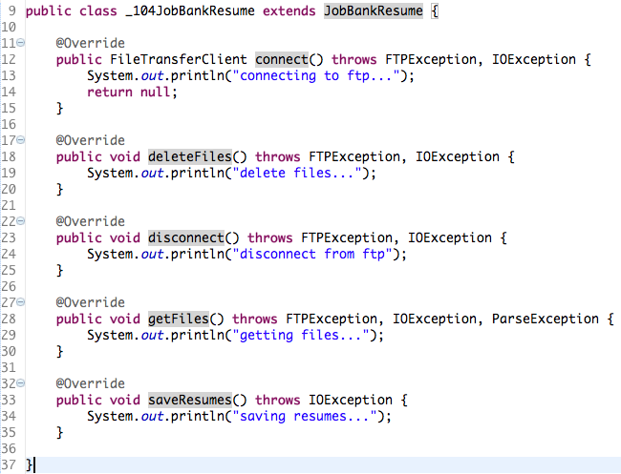

Concrete Class for 104 job bank
extends abstract class
Implement operation in each method

Slide 11
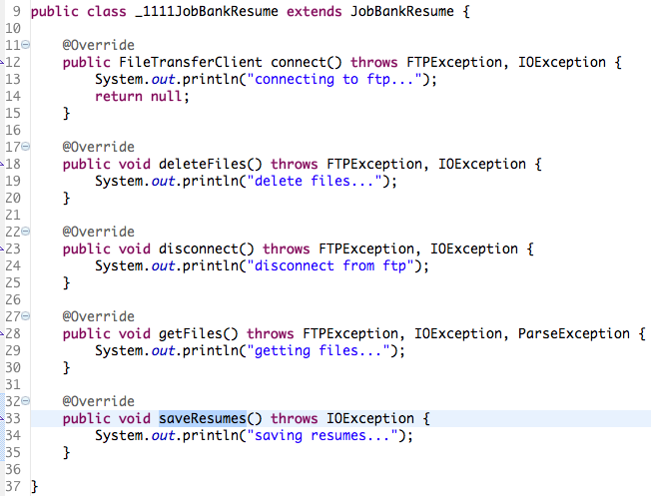
Concrete Class for 1111 job bank
extends abstract class
Implement operation in each method

Slide 12
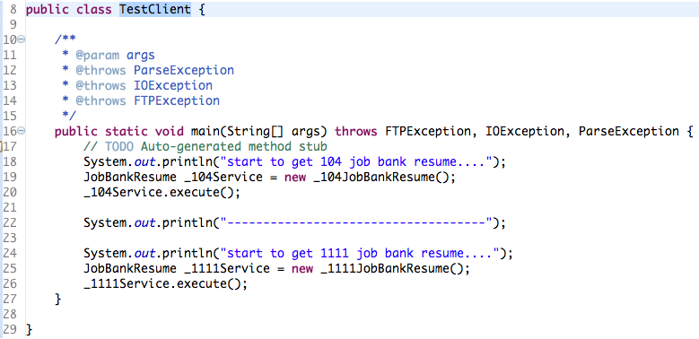

Test Client
As 104Service and 1111Service call execute method,
it will call connect(), getFiles(), deleteFiles(), disconnect(),
saveResumes() sequentially.

Slide 13
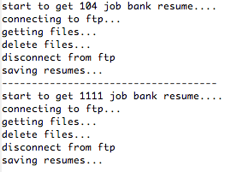
Test Client -- Result

Slide 14
Implementation

Slide 15
Pros and Cons
Pros :
It is a natural fit for building frameworks in which the parent framework classes can make calls into methods implemented in child.
Avoid code duplication, implementing variations of the algorithm in subclass.
Cons :
Program flow is little more difficult to follow without the help of stepping through the code with a debugger.
Communicates intent poorly - Difficult to differentiate between hooks and invariant methods.

Slide 16
Thank You

